Slide 1
Unitil Grid Modernization
The New England Electricity Restructuring Roundtable
Presented by Justin Eisfeller
Sept 25, 2015

Slide 2
Meeting Objectives
GMP Background and Drivers
Review projects included in the STIP
BCA Overview
Review Positions Taken, Tactical Approach

Slide 3
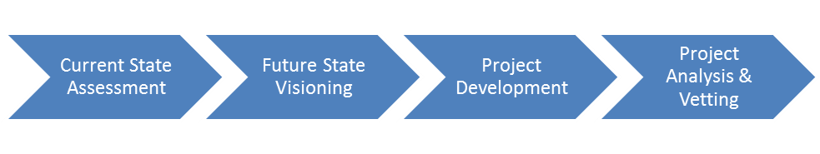
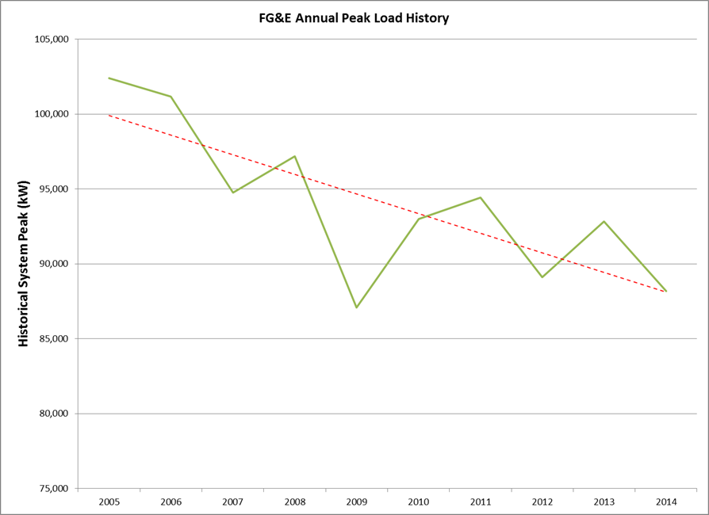
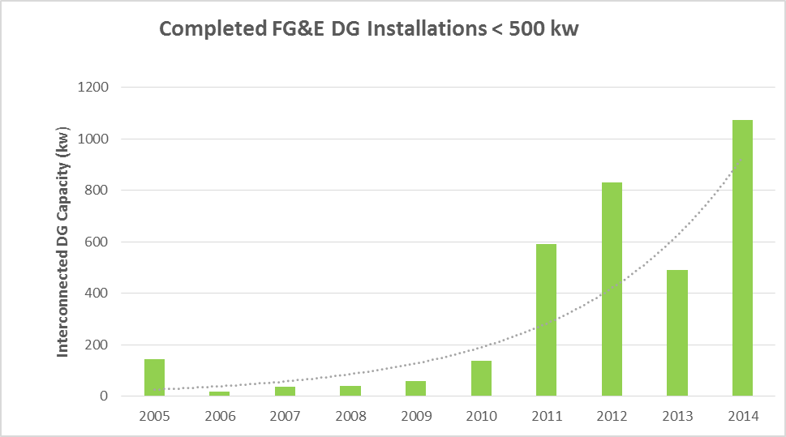
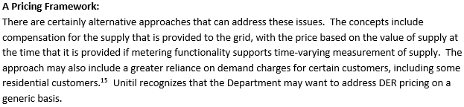
GMP Background and Drivers
Unitil undertook a detailed, deliberate approach to develop the GMP
Overview of FGE System and Service Territory
  Sustainable pricing – a key driver
  Declining Load (EE and DG impacts)
Unitil proposes to be an enabling platform
Theme of “Practical Grid Mod”
The GMP projects are responsive to DPU objectives and Unitil’s vision

Slide 4
Unitil Grid Modernization Programs
A
DER Enablement Program
Accommodate and maintain reliability, realign pricing/economics, support utility enabled energy efficiency
B
Grid Reliability Program
Maintain reliability, avoid penalties and ensure strong restoration performance
C
Distribution Automation Program
Make the grid more flexible and efficient
D
Customer Empowerment Program
Put information and tools in the hands of our customers
E
Workforce & Asset Management Program
Reduce OpEx, improve outage response, and optimize asset life/value
Notes:
Objectives of Order:
reduce the effects of outages;
optimize demand, which includes reducing system and customer costs;
integrate distributed resources; and
improve workforce and asset management

Slide 5
GMP Projects by Program Area
DER Enablement
Reliability
Distribution Automation
Customer Empowerment
Workforce & Asset Management
A.1 Tariff for customer owned DG
A.2 Circuit capacity study
A.3 Website for prequalifying DG
A.4 DG monitoring and control pilot
A.5 DER analytics and visualization platform
A.6 3V0 protection at substations
A.7 Substation Voltage Regulation Controls
A.8 DER Monitoring (RD&D)
AL.1 Energy Storage- Battery Farm
B.1 Reduce the SRP cycle to 5 years
B.2 Enhance hazard tree program
B.3 #6 Copper replacement
B.4 Install jacketed tree wire or spacer cable
B.5 Breakaway service connector
B.6. BI dashboard
B.7 Improved ETR tool
B.8 Integrate Enterprise mobile damage assessment tool
B.9 Integrate AMS with OMS
B.10 OMS Resiliency – Hot Standby
BL.1 Proactive pole inspection
BL.2 Class B Dist. Stds
BL.3 Pole loading study
BL.4 Replace UG cable
BL.5 Undergrounding
BL.6 Probabilistic Outage prediction
BL.7 Crew Callout System
BL.8 Planned Outage Tool
C.1 Auto 69 kV substation switches
C.2 Auto cap banks for VVO
C.3 Auto voltage for VVO
C.4 Auto LTCs for VVO
C.5 SCADA comms to FGE substations
C.6 Field Area Network for DA
C.7 ADMS
C.8 Auto sectionalizing and restoration
C.9 Energy efficiency tariff
CL.1 SCADA fault indicators - FLISR
CL.2 Automated reclosers – FLISR
CL.3 FLISR ADMS module
D.1 Energy information web portal
D.2 Customer mobile app
D.3 Gamification pilot
D.4 Customer education program
D.5 Pre-payment
D.6 TVR AMS
D.7 Behind meter interface std
DL.1 Control of appliances
E.1 Mobility platform for field work
E.2 AVL for foreign crews
E.3 WOMS
E.4 Condition based maintenance program
E.5 BI dashboard for asset health and performance
5

Slide 6
GMP Projects by Program Area
DER Enablement
Reliability
Distribution Automation
Customer Empowerment
Workforce & Asset Management
A.2 Circuit capacity study
A.5 DER analytics and visualization platform
A.6 3V0 protection at substations
A.7 Substation Voltage Regulation Controls
B.8 Integrate Enterprise mobile damage assessment tool
B.9 Integrate AMS with OMS
C.2 Auto cap banks for VVO
C.3 Auto voltage for VVO
C.4 Auto LTCs for VVO
C.5 SCADA comms to FGE substations
C.6 Field Area Network for DA
C.7 ADMS
D.1 Energy information web portal
D.3 Gamification pilot
D.6 TVR AMS
E.1 Mobility platform for field work
Note: The original list was 52 projects
6

Slide 7
AMF and TVR
Mandatory TVR
Deemed too expensive ($12M cost with $3.3 Million in Benefits)
Existing smart meters will have to be replaced but have not reached the end of their useful life
Municipal aggregation may also impact participants
Proposal is to build out AMF network and offer an optional TVR
Opt-in TVR with CPP:
Residential and small commercial $2.1 M Cost with $1M in benefits
Participants responsible for meter upgrade cost
Build out of network complete over a three year period
On-Peak to Off-Peak ratio is 3.28
CPP to Off Peak ratio is 7.67
Notes:
Off Peak: 0.05554 $ / kWh
On Peak: 0.18231 $ / kWh
Critical Peak: 0.42639 $ / kWh

Slide 8
Roadmap View
Low cost, high benefit projects implemented first
Under new timeframe key foundational capabilities are launched
  Reliability projects
  Distribution Automation
  Communications
As capabilities are added customer tools go online
AMF Deployment deployed as Opt-In
  Timeframe approaches end of life for current platform

Slide 9
BCA Summary
by Program Area (15 Year Timeframe in Net Present Value)
Program | Benefits ($K) | Costs ($K) | B/C Ratio
Distribution Automation | $13,551 | $13,632 | 0.99
Grid Reliability | $7,265 | $559 | 13.00
Workforce & Asset Management | $6,625 | $365 | 18.15
Customer Empowerment | $1,987 | $2,566 | 0.77
DER Enablement | $106 | $3,304 | 0.03
Overall | $29,533 | $20,426 | 1.5
Benefits Comparison (10 Year Nominal Values)
Program | Grid Benefits | Customer Benefits | Total Benefits
DER Enablement | $0 | $100 | $100
Grid Reliability | $556 | $6,115 | $6,671
Distribution Automation | $0 | $10,800 | $10,800
Customer Empowerment | $126 | $1,318 | $1,444
Workforce and Asset Management | $378 | $5,796 | $6,174
Total | $1,060 | $24,129 | $25,189

Slide 10
Key Positions Taken in GMP
GMP investments are incremental investment for Unitil
  Application of tracker should extend beyond initial five years and recover capital as well as O&M
DER Strawman
  Articulation of new rate design that recovers value of the grid & fairly values DG supply
Presenting AMF and TVR on an opt-in basis
  Opt-out requires significant incremental AMI investment
  Allows foundational comms capability to be deployed first
  Completion of current AMI useful life

